Slide 1
AGM (ACTUAL AND VIRTUAL)
CHAIR & TREASURERS REPORT
FOR FINANCIAL YEAR 2020/21
Thomas Tallis Parent, Teachers and Friends Association (PTFA)
Charity Number | 281939
20TH OCTOBER 2021
9:30am
in The Gallery

Slide 2
Parent, Teacher and Friends Association
AGM Agenda
20th October 2021
1. Introductions & Apologies for absence
2. Minutes of previous AGM
3. Chair’s report
4. Financial report
5. Election of committee
6. Other AGM business - Close AGM
7. General meeting
1. Community Garden - James Baker
2. RE funding request for Astronomy & Islam program- Rahima Choudhury
3. 2nd hand uniform
4. TECH for TALLIS
5. Community page
6 Events/Ideas - Games night Yr 7/8, Comedy night/Tallis is 50
7 Any other business
8. Date of next meeting.

Slide 3
Overview
This years report in essence is very similar to the previous years as our ability to run school community events continued to be restricted by Covid-19. However, as before we continued to uphold our charities commitment to provide a link between home and school and through our 2 main projects ,TECH for TALLIS and 2nd Hand Uniform we continued to raised funds along the way to enhance our kids learning.
TECH for TALLIS
Covid-19 meant that between the 19-21 academic years the PTFA’s attention and efforts were diverted to finding a way to support many of our pupils affected by limited or no access to Technology at home.
TECH for TALLIS was born in the April of 2019 and is here to stay.
Here’s whats been achieved so far!
30 + Second hand devices have been refurbished and passed on to students
48 NEW laptops have been purchased using PTFA funds and loaned to students
Sadly refurbishing 2nd hand devices is no longer sustainable from a staffing and practical point of view and so has been postponed currently.
However, the Fundraising side of the scheme will continue so that we can fulfil our commitment to ensure that all Tallis pupils who are not eligible for government devices have access to IT at home each time a new cohort of Yr 7’s arrive.
Raised to date: £9333
To donate to the campaign, go to:

Slide 4
2nd Hand Uniform
We continued our commitment to Reduce, Reuse & Recycle made in the 2018/19 AGM by keeping as much uniform out of landfill as we can.
Throughout 20/21 we dealt with requests as and when they came in with the help of the amazing Tallis Reception staff who very kindly received, sorted and handed out items when requested.
We also held 2 sale dates in the Summer Holidays which were very popular and thanks to all parents and especially 2 then Yr 10 Pupils Leo Elder and Joshua Caldwell for helping on the till.
So far the scheme has raised approx. £1200 to date
We still have a good stock of good quality 2nd hand uniform left which can be requested via: https://www.thomastallisschool.com/second-hand-uniform-scheme.html and is also providing a supply of back up uniform for school staff to allocate to pupils when needs arise.

Slide 5
But in true PTFA style we luckily had other things on the go that still meant that we continued to raise ever needed funds and provisions for the kids at Tallis. Our online fundraising platforms continue to bring in a steady flow of money allowing the school community to show their support when they shop online by grabbing FREE donations from retailers and giving it straight to the Tallis Kids.
Click here to join between 20th Oct - 30th Nov to collect £15 bonus!

Slide 6
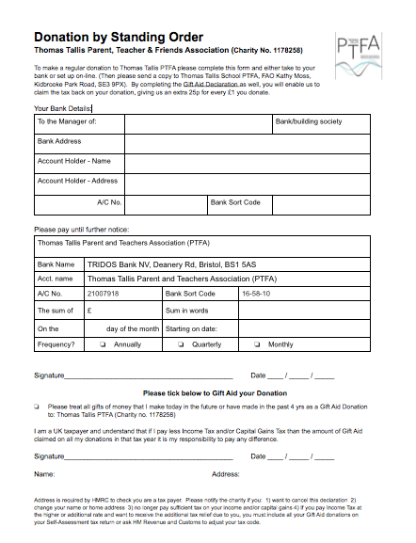
One off & Monthly donations
We are also very grateful to families who have given One off donations or have set up a monthly standing orders. Donations such as these are a great way for supporters to help our cause when they have limited time to be directly involved in fundraising. This year we have raised £170 via this method and we hope to invite more families to choose this option if they are willing and able.
Standing order form
Gift aid (Email version to copy and paste)
Dear Treasurer/Gift Aid Secretary of
Thomas Tallis Parent Teach and Friends Association
I would like Thomas Tallis PTFA (Charity no. 117825) to treat all gifts of money or donations of goods made from the date of this declaration, in the future and in the past four years as Gift Aid donations until I notify you otherwise.
Yes, I am a UK taxpayer and I understand that if I pay less Income Tax and/or Capital Gains Tax than the amount of Gift Aid claimed on all my donations in that tax year it is my responsibility to pay any difference.
Full Name:
Address
Moneys raised for other charities
We also had a successful virtual Macmillan Coffee morning in September 2020 raising a record breaking £365

Slide 7
Overview of accounts
Below is an outline of money that has been raised, passed on to the Tallis and where it has been put to good use: For more details see our full Treasurers report document (copy on the next slide)
Main Fundraisers of 2020/21
TECH for TALLIS £6,214.00
2nd Hand Uniform £689.00
Easyfundraising (approx.) £515.00
Other platforms not yet transferred
Other (Standing order/D/D’s) £170.00
Monies passed to Tallis 2020/21
Purchase of 21 new laptops £5339.00
Community Garden £1,000.00

Slide 8
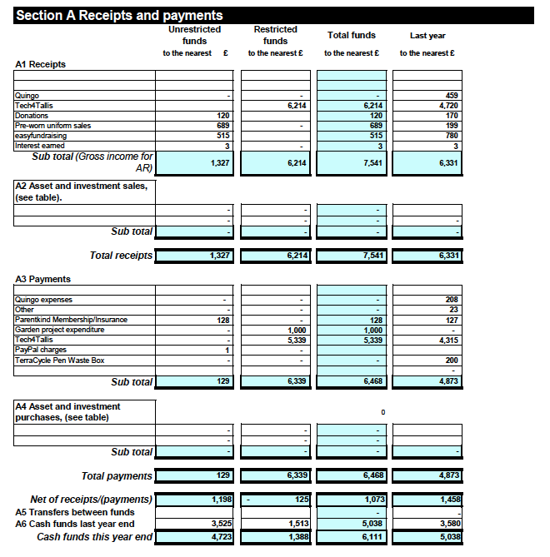
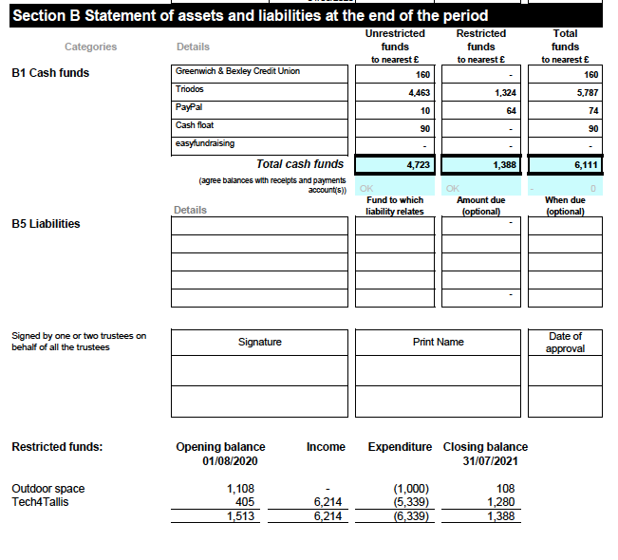

Slide 9
PTFA Aims going forward
Thanks
Thanks to everyone who has helped this last year to keep things going in such a strange time.
Special thanks must be given to our outgoing treasurer Kathy Moss who has worked alongside me as an initial PTFA Charity Trustee (even before we were a registered charity) and who carried on even after her daughters graduated from Tallis. Kathy has been instrumental in the success of the PTFA and will be greatly missed but her wisdom and support has already been passed on to our new incoming volunteer Stuart Popple. Huge thanks also go to Mr Tom Williams for agreeing to continue in his role as our Teacher Trustee. I am happy to continue in my role as Chair for this year but will be stepping down at the end of 2022 academic year but I am already immensely confident that the new cohort of PTFA trustees, Without Portfolio members and new parents on the scene will be a huge success and I will assist them during this year to enable a smooth transition.
Our Aims…
Increase Easyfundraising and Amazon Smile supporters to 200 +
Increase Monthly donations via standing orders/direct debits.
To secure some ‘Match Funding’ from businesses/corporations within the Parent/Friend community
To engage with all diversities within our school community to ensure we are representing all.
To start up a Tallis Community Hub to champion and support projects and business within our parent cohort.
To continue to work and support the school with initiatives that the PTFA feel will benefit the majority and that fall within our constitution.
To set up smaller working groups for:
BAME Online Fundraising schemes Environment/Sustainability/Garden 2nd Hand Uniform Year group reps
Report produced by Angie Elder - Chair of Tallis PTFA

